Slide 1
WALMART ANALYSIS
PostgreSQL

Slide 2
Create Table
CREATE TABLE sales(
invoice_id VARCHAR NOT NULL PRIMARY KEY,
branch VARCHAR NOT NULL,
city VARCHAR NOT NULL,
customer_type VARCHAR NOT NULL,
gender VARCHAR NOT NULL,
product_line VARCHAR NOT NULL,
unit_price DECIMAL NOT NULL,
quantity INT NOT NULL,
tax_pct DECIMAL NOT NULL,
total DECIMAL NOT NULL,
date DATE NOT NULL,
time TIME NOT NULL,
payment VARCHAR NOT NULL,
cogs DECIMAL NOT NULL,
gross_margin_pct DECIMAL,
gross_income DECIMAL,
rating DECIMAL );

Slide 3
--- Copy the Dataset into the Table :
COPY sales FROM 'E:\share\Intel\walmart_sql project\WalmartSalesData.csv.csv' DELIMITER ‘,’ csv header;
--- Add the time_of_day column :
SELECT time,
(CASE WHEN time BETWEEN ‘00:00:00’ AND ‘12:00:00’ THEN ‘Morning’
WHEN time BETWEEN ‘12:01:00’ AND ‘16:00:00’ THEN ‘Afternoon’
ELSE ‘Evening’
END) AS time_of_day
FROM sales;
ALTER table sales
ADD time_of_day VARCHAR;
UPDATE sales
SET time_of_day = (SELECT CASE WHEN time BETWEEN ‘00:00:00’ AND ‘12:00:00’ THEN ‘Morning’
WHEN time BETWEEN ‘12:01:00’ AND ‘16:00:00’ THEN ‘Afternoon’
ELSE ‘Evening’
END);

Slide 4
-- Add the month_name column :
SELECT date,
LOWER(TO_CHAR(date,‘month’)) AS monthname
FROM sales;
ALTER table sales
ADD COLUMN month_name VARCHAR;
UPDATE sales
SET month_name = (SELECT
LOWER(to_char(date,‘month’)))

Slide 5
-- Add the date_name column :
SELECT date,
LOWER(TO_CHAR(date,‘day’)) AS datename
FROM sales;
ALTER table sales
ADD COLUMN date_name VARCHAR;
UPDATE sales
SET date_name = (SELECT
LOWER(to_char(date,‘day’)))

Slide 6
ANALYSIS LIST
1.Product Analysis
Conduct analysis on the data to understand the different product lines the
products lines performing best and the product lines that need to be improved.
2.Sales Analysis
This analysis aims to answer the question of the sales trends of product. The
result of this can help use measure the effectiveness of each sales strategy the
business applies and what modifications are needed to gain more sales.
3.Customer Analysis
This analysis aims to uncover the different customers segments, purchase trends
and the profitability of each customer segment.

Slide 7
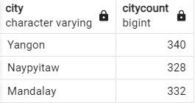
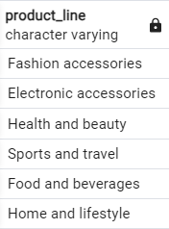
Product Analysis
1. How many unique cities does the data have and their count?
SELECT city,
COUNT(city) AS city_count
FROM sales
GROUP BY time_of_day;
2. How many unique product lines does the data have?
SELECT DISTINCT(product_line)
FROM sales;

Slide 8

3. What is the most selling product line ?
SELECT product_line,
SUM(quantity) AS quantity
FROM sales
GROUP BY product_line
ORDER BY quantity DESC
LIMIT 1;
-- Alternative
SELECT * FROM ( SELECT DISTINCT(product_line),
SUM(quantity) OVER(PARTITION BY product_line) AS quantity
FROM sales
) AS x
ORDER BY x.quantity DESC
LIMIT 1;

Slide 9
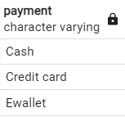
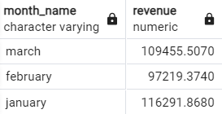
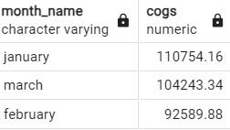
4. What is the most common payment method?
SELECT DISTINCT(payment)
FROM sales
GROUP BY payment;
5. What is the total revenue by month?
SELECT month_name,
SUM(total) AS revenue
FROM sales
GROUP BY month_name;
6. What month had the largest COGS?
SELECT month_name,
SUM(cogs) AS cogs
FROM sales
GROUP BY month_name
ORDER BY cogs DESC;

Slide 10
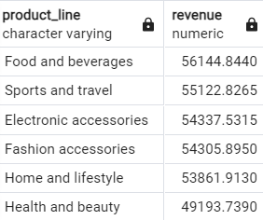
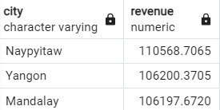
7. What product line had the largest revenue?
SELECT product_line,
SUM(total) AS revenue
FROM sales
GROUP BY product_line
ORDER BY revenue DESC;
8. What is the city with the largest revenue?
SELECT city,
SUM(total) AS revenue
FROM sales
GROUP BY city
ORDER BY revenue DESC;

Slide 11
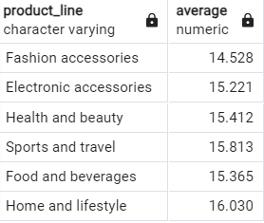
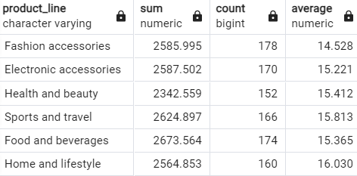
9. What product line had the largest VAT?
SELECT product_line,
ROUND(AVG(tax_pct),3) AS average
FROM sales
GROUP BY product_line;
-- Overall Calculation
SELECT product_line,
ROUND(SUM(tax_pct),3) AS sum,
COUNT(tax_pct),
ROUND(AVG(tax_pct),3) AS average
FROM sales
GROUP BY product_line;

Slide 12
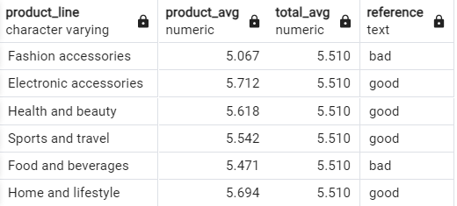
10. Fetch each product line and add a column to those product line showing "Good",
"Bad". Good if its greater than average sales.
SELECT product_line,
ROUND(AVG(quantity),3) AS product_avg,
ROUND((SELECT AVG(quantity) FROM sales),3) AS total_avg,
CASE when (SELECT AVG(quantity) FROM sales) < AVG(quantity) then 'good'
ELSE 'bad'
END AS reference
FROM sales
GROUP BY product_line;

Slide 13
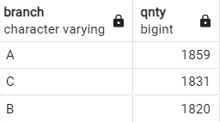
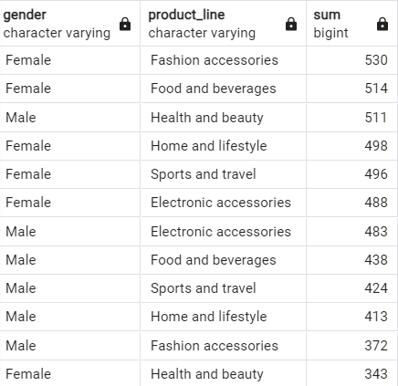
11. Which branch sold more products than average product sold?
SELECT branch,
SUM(quantity) AS qnty
FROM sales
GROUP BY branch
HAVING SUM(quantity) > (SELECT AVG(quantity) FROM sales);
12. What is the most common product line by gender?
SELECT gender,
product_line,
SUM(quantity)
FROM sales
GROUP BY gender,
product_line
ORDER BY SUM(quantity) DESC;

Slide 14
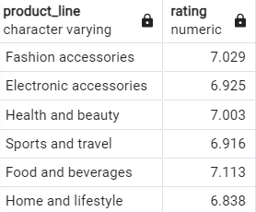
13. What is the average rating of each product line ?
SELECT product_line,
ROUND(AVG(rating),3) AS rating
FROM sales
GROUP BY product_line;

Slide 15
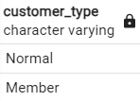
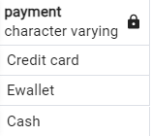

Customer Analysis
1. How many unique customer types does the data have?
SELECT DISTINCT(customer_type)
FROM sales;
2. How many unique payment methods does the data have?
SELECT DISTINCT(payment)
FROM sales;
3. What is the most common customer type?
SELECT customer_type ,
COUNT(customer_type) AS cnt
FROM sales
GROUP BY customer_type
ORDER BY cnt DESC
LIMIT 1 ;

Slide 16

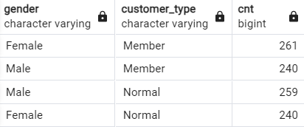
4. Which customer type buys the most?
SELECT customer_type,
SUM(quantity) AS cnt
FROM sales
GROUP BY customer_type
ORDER BY cnt DESC
LIMIT 1;
5. What is the gender of most of the customers?
SELECT gender,
customer_type,
COUNT(customer_type) AS cnt
FROM sales
GROUP BY gender ,
customer_type;

Slide 17
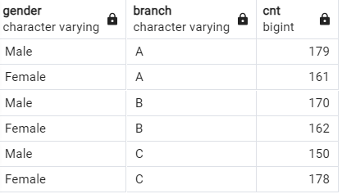
6. What is the gender distribution per branch?
SELECT gender,
branch,
COUNT(branch) AS cnt
FROM sales
GROUP BY gender,
branch
ORDER BY branch,
gender DESC;

Slide 18
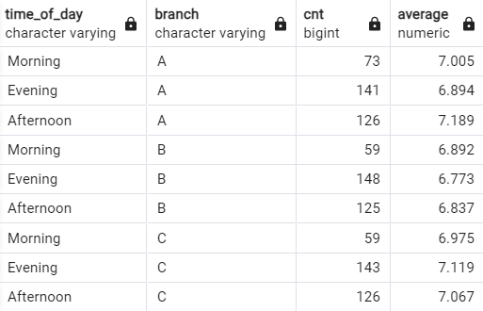
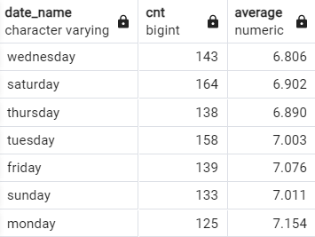
7. Which time of the day do customers give most ratings per branch?
SELECT time_of_day,
branch,
COUNT(rating) AS cnt,
ROUND(AVG(rating),3) AS average
FROM sales
GROUP BY time_of_day,
branch
ORDER BY branch,
time_of_day DESC;
8. Which day of the week has the best avg ratings?
SELECT date_name,
COUNT(rating) AS cnt,
ROUND(AVG(rating),3) AS average
FROM sales
GROUP BY date_name;

Slide 19
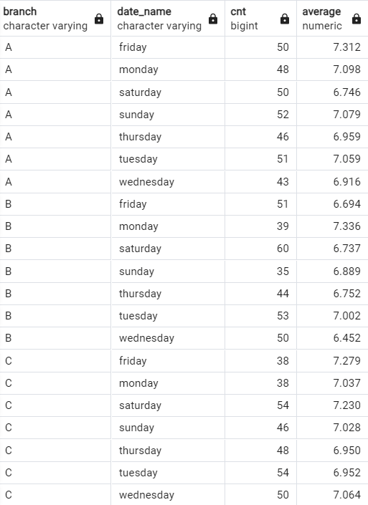
9. Which day of the week has the best average ratings per branch?
SELECT branch,
date_name,
COUNT(rating) AS cnt,
ROUND(AVG(rating),3) AS average
FROM sales
GROUP BY branch,
date_name
ORDER BY branch,
date_name;

Slide 20
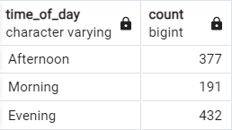
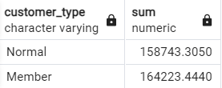
Sales Analysis
1. Number of sales made in each time of the day per weekday?
SELECT time_of_day,
COUNT(quantity)
FROM sales
GROUP BY time_of_day;
2. What is the revenue generated by customer?
SELECT customer_type,
SUM(total)
FROM sales
GROUP BY customer_type;

Slide 21
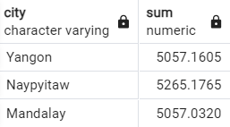
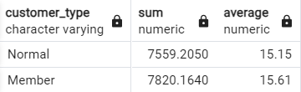
3. Which city has the largest tax/VAT percent?
SELECT city,
SUM(tax_pct)
FROM sales
GROUP BY city;
4. Which customer type pays the most in VAT?
SELECT customer_type,
SUM(tax_pct),
ROUND(AVG(tax_pct),2) AS average
FROM sales
GROUP BY customer_type;

